Slide 1
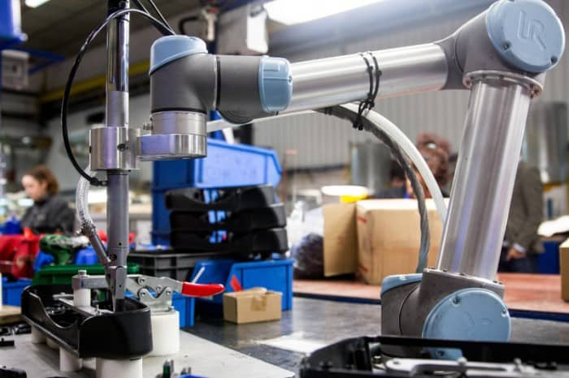

CSC485B Machine Learning for Robotics
SUNY Plattsburgh
Dr. Ned Lecky
Class 10- Intro to Classification

Slide 2

Classification
X
F
y={0, 1, 2…}
Where $y∈Ζ=\{0, 1, 2, …\}$
We can define the integers to mean different classes of objects
{dog, cat}
{good part, bad part}
{good part, part with bent corner, part with hole in it}
We can use a regressor as a classifier, but it causes weird results
For example, Square=0, Triangle=1, Circle=2
So something that is sort of a squarish circle gets called a $\frac{0+2}{2}=1$triangle??
I Am a Triangle?

Slide 3
A Common Fix
X
Square Detector
y1={0, 1}
Use multiple single-output regressors
Y = [y1, y2, y3]
Hopefully only one is True
“One-hot” encoding
And then we can make a wrapper
Return int indicating which yn has the strongest result
Voting
Classifier algorithms often just do this internally
X
Triangle Detector
y2={0, 1}
X
Circle Detector
y3={0, 1}

Slide 4
Working Through Test Data
Let’s experiment with some simple test data
https://github.com/nedlecky/CSC485B/blob/main/CSC485_200_PartClassifierStudy.ipynb
Synthesizing data…
Many different algorithms but mostly it’s
Regression-ish, and
DecisionTree-ish
Can we influence success by improving the data?

Slide 5
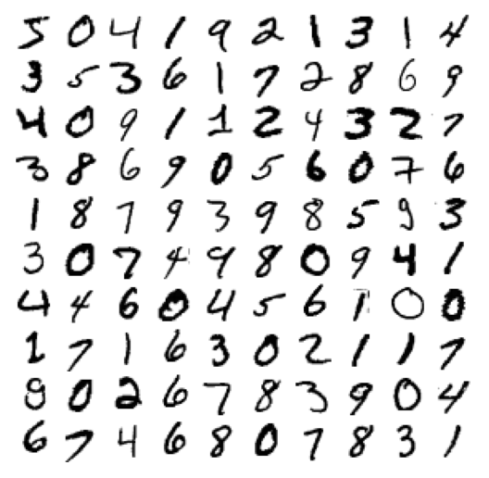
Something More Complex
How about the MNIST test data
70,000 handwritten characters
Segmented into 28x28 (784 pixel) squares
Our classifier X is
70000 x 784

Slide 6
Working Through the Book Example
We’ll walk through Ageron Ch. 3 with the MNIST data
https://colab.research.google.com/github/ageron/handson-ml3/blob/main/03_classification.ipynb
The performance is pretty terrible, generally
How could we make it better?

Slide 7

Better Features than Individual Pixels
Maybe we compute a much smaller set of (more invariant) features
Start looking at black/white ratios in each grid and their ratios
LEOcr!
Feature Extraction and Dimensionality Reduction are coming in our course!!
Image Reduction, too!

Slide 8
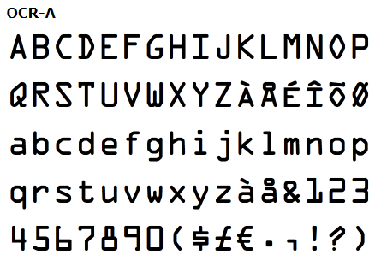
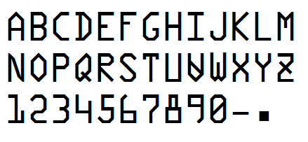
Or… if you’re printing
Keep the characters very different
OCR-A
Semi (for semiconductor industry)

